Slide 1

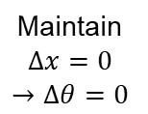


Maintain $∆F=0$
Pilot Foot
Pilot Force
Ground
Suit Force
Forward Proximity
$$x_{Forward}$$
Maintain
$$∆x=0$$
$$→∆θ=0$$
Pilot Thigh
Pilot Shin
Rear Proximity
$$x_{Rear}$$

